Slide 1
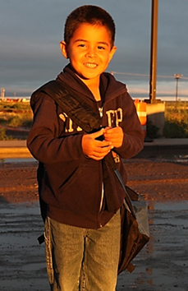
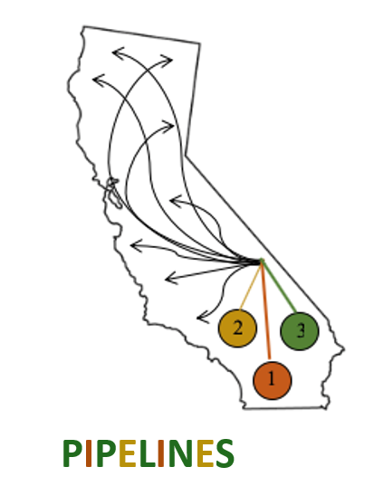
Discover Personas: A New Tool to Support Your Work
Presented by
Camille Catlett and Sarah Garrity
February 17, 2022
                Sponsored by

Slide 2
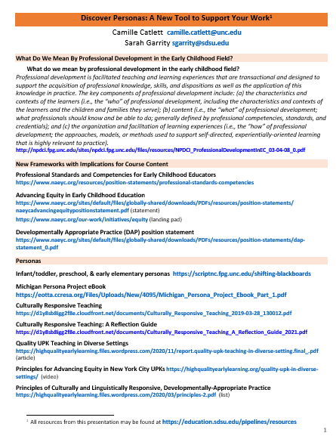
Handout, PowerPoints, & recording will be available on the PIPELINES website https://education. sdsu.edu/pipelines/resources

Slide 3
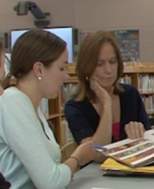
Definition of Professional Development
“Professional development is facilitated teaching and learning experiences that are transactional and designed to support the acquisition of professional knowledge, skills, and dispositions as well as the application of this knowledge in practice…..
Source: National Professional Development Center on Inclusion (NPDCI)
Notes:
3
Source: National Professional Development Center on Inclusion. (2008). What do we mean by professional development in the early childhood field? Chapel Hill: The University of North Carolina, FPG Child Development Institute, Author.
http://npdci.fpg.unc.edu/sites/npdci.fpg.unc.edu/files/resources/NPDCI_ProfessionalDevelopmentInEC_03-04-08_0.pdf

Slide 4
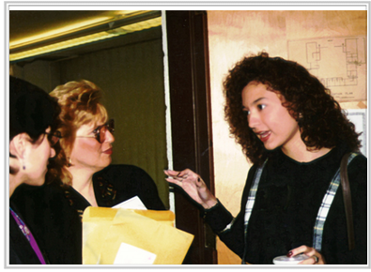
Definition (continued)
The key components of professional development include:
  characteristics and contexts of the learners (i.e., the “who” );
  content (i.e., the “what” of professional development); and
  organization and facilitation of learning experiences (i.e., the “how”).”
Notes:
Source: National Professional Development Center on Inclusion. (2008). What do we mean by professional development in the early childhood field? Chapel Hill: The University of North Carolina, FPG Child Development Institute, Author.
http://npdci.fpg.unc.edu/sites/npdci.fpg.unc.edu/files/resources/NPDCI_ProfessionalDevelopmentInEC_03-04-08_0.pdf

Slide 5


Slide 6

STANDARD 1
Child Development and Learning in Context
Early childhood educators (a) are grounded in an understanding of the developmental period of early childhood from birth through age 8 across developmental domains. They (b) understand each child as an individual with unique developmental variations. Early childhood educators (c) understand that children learn and
develop within relationships and within multiple contexts, including families, cultures, languages, communities, and society. They (d) use this
multidimensional knowledge to make evidence-based decisions about how to carry out their responsibilities

Slide 7

2.
[Equity is] the state that would be achieved if individuals fared the same way in society regardless of race, gender, class, language, disability, or any other social or cultural characteristic. In practice, equity means all children and families receive necessary supports in a timely fashion so they can develop their full intellectual, social, and physical potential.
- NAEYC, 2019

Slide 8

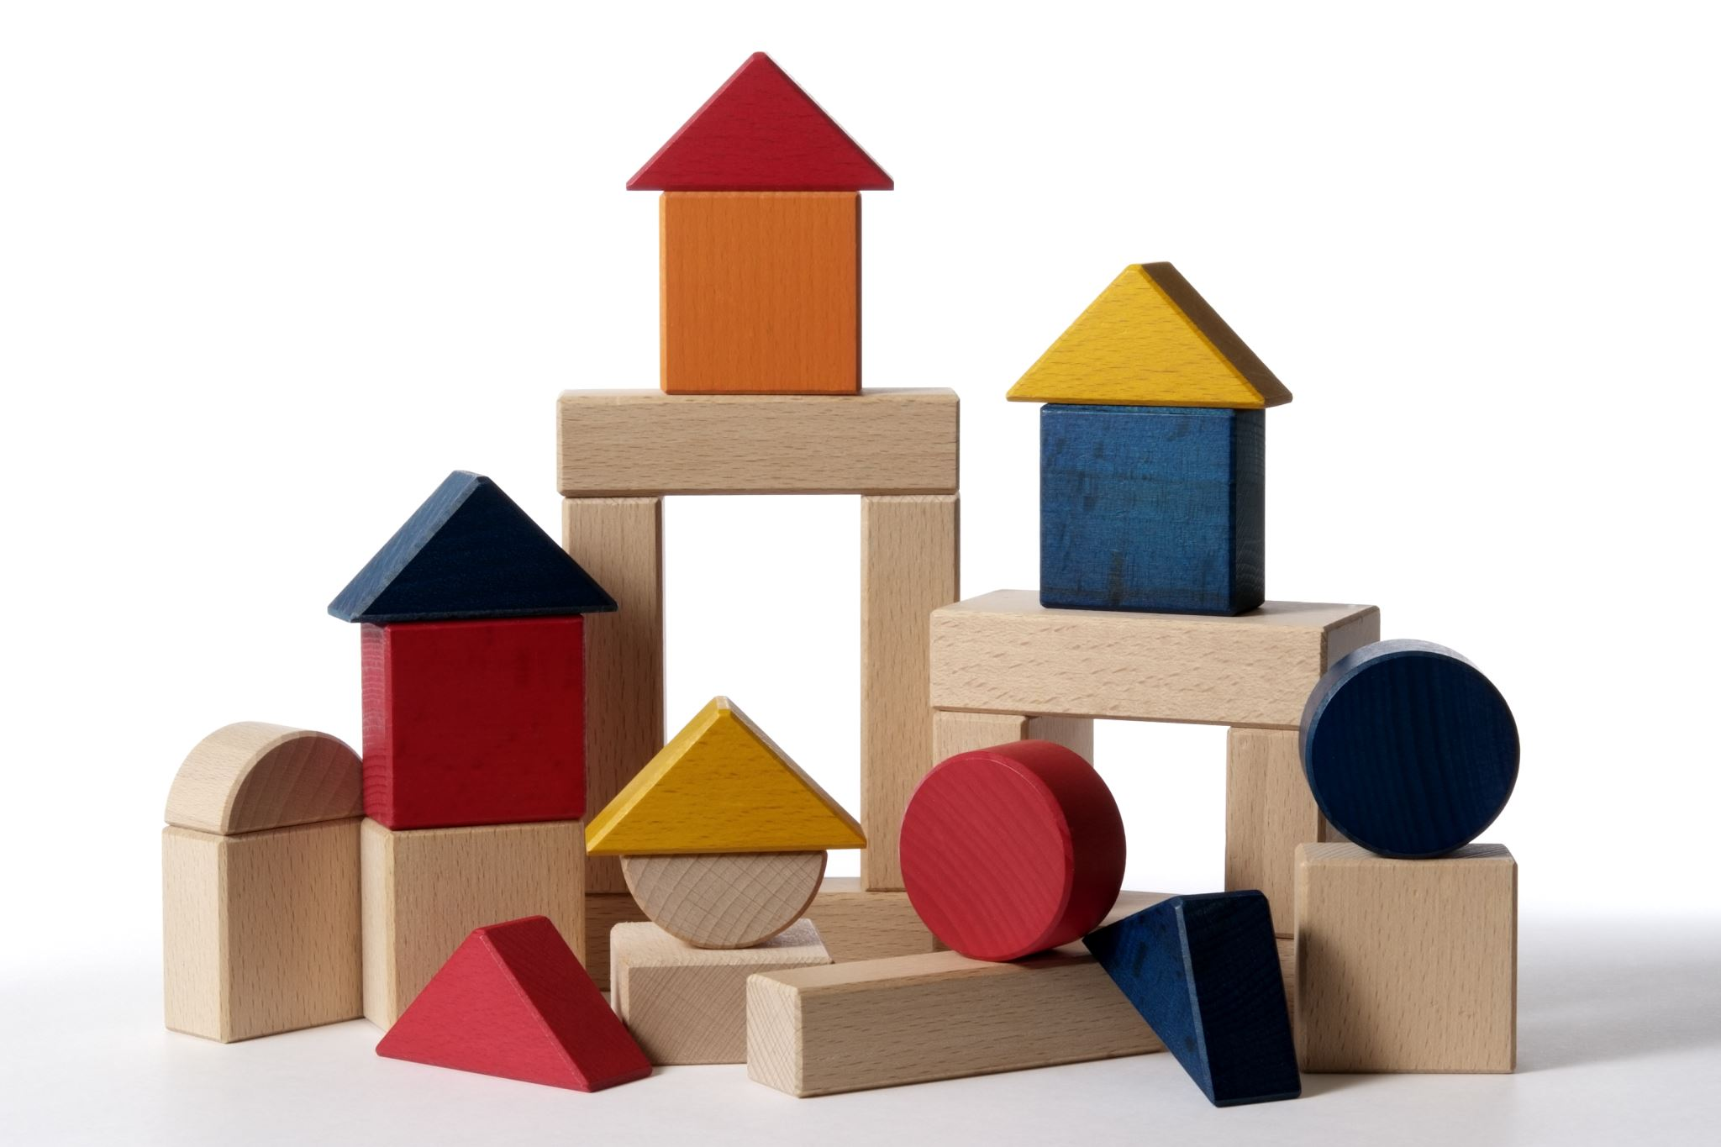
Developmentally Appropriate Practice (NAEYC, 2020)
Each and every child, birth through age 8, has the right to equitable learning opportunities—in centers, family childcare homes, or schools—that fully support their optimal development and learning across all domains and content areas. Children are born eager to learn; they take delight exploring their world and making connections. The degree to which early learning programs support children’s delight and wonder in learning reflects the quality of that setting. Educators who engage in developmentally appropriate practice foster young children’s joyful learning and maximize the opportunities for each and every child to achieve their full potential.

Slide 9

What DAP is Asking of Us
Yet even as they grapple with their own institutional biases and inequities, professional preparation programs and ongoing professional development systems must orient themselves towards consistently and effectively preparing and supporting educators to reflect on and address their own inherent biases and to help them provide developmentally, culturally, and linguistically responsive learning experiences to an increasingly diverse population of children.
Developmentally Appropriate Practice, p. 4

Slide 10
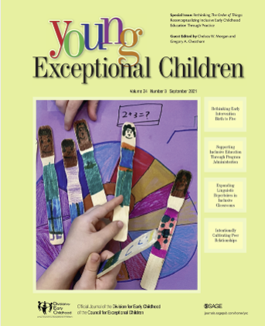
“We recognize inclusive education as the process of (a) redistributing access to and participation in quality learning opportunities; (b) recognizing and valuing all child differences in learning activities, materials, and interactions; and (c) creating opportunities for non-dominant and under-represented groups to share their narratives and advance solutions for equity, with particular attention given to the interplay of multiple and intersecting social identities (e.g., ability, race, language) in learning contexts (e.g., home, school, and community settings)”
(YEC September 2021, page 115)
Notes:
C2

Slide 11
How can faculty, instructors, and professional development providers give students experience with diverse children and families, especially during a pandemic?

Slide 12
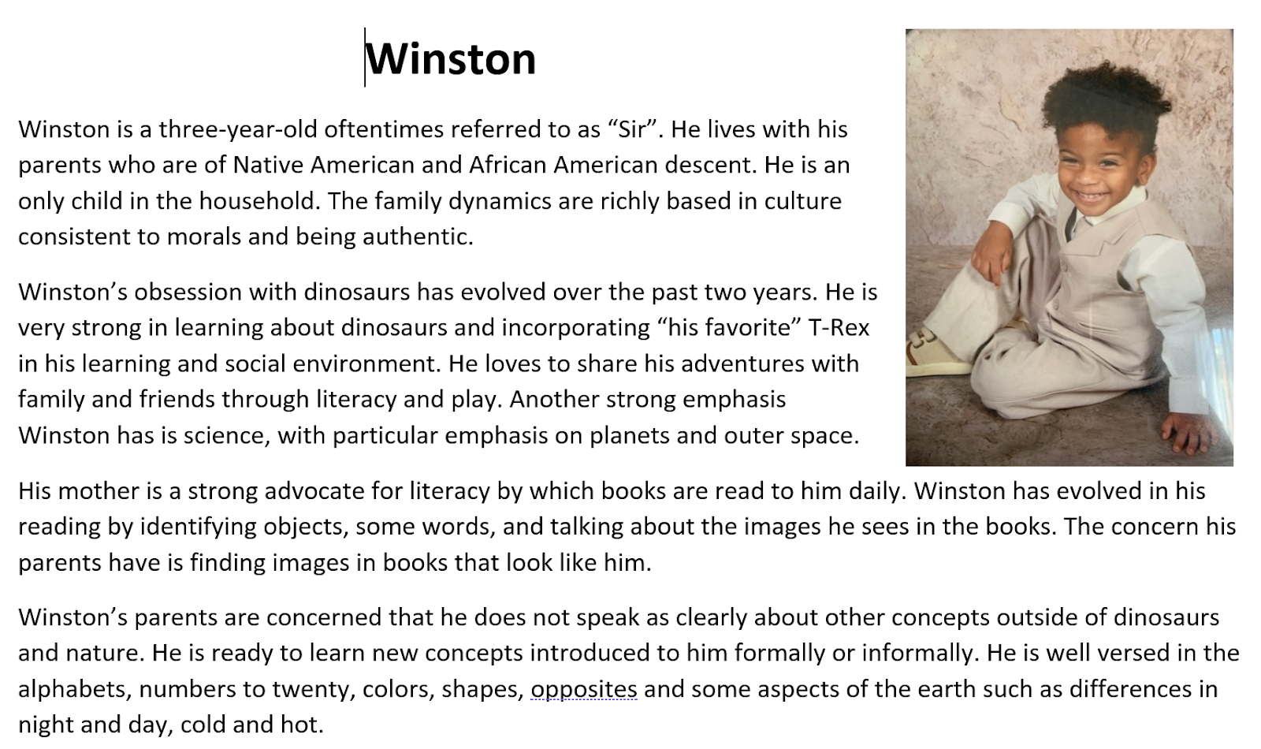
What is a persona?
Personas are brief descriptions that present a short sketch of a child and family. Each persona offers information about the unique composition of a family, details about a child (name, age, likes, dislikes), and insights to who the child is as a learner. The insights reveal things like whether a child is receiving services for a disability, is a dual language learner, or has experienced traumatic life circumstances.

Slide 13
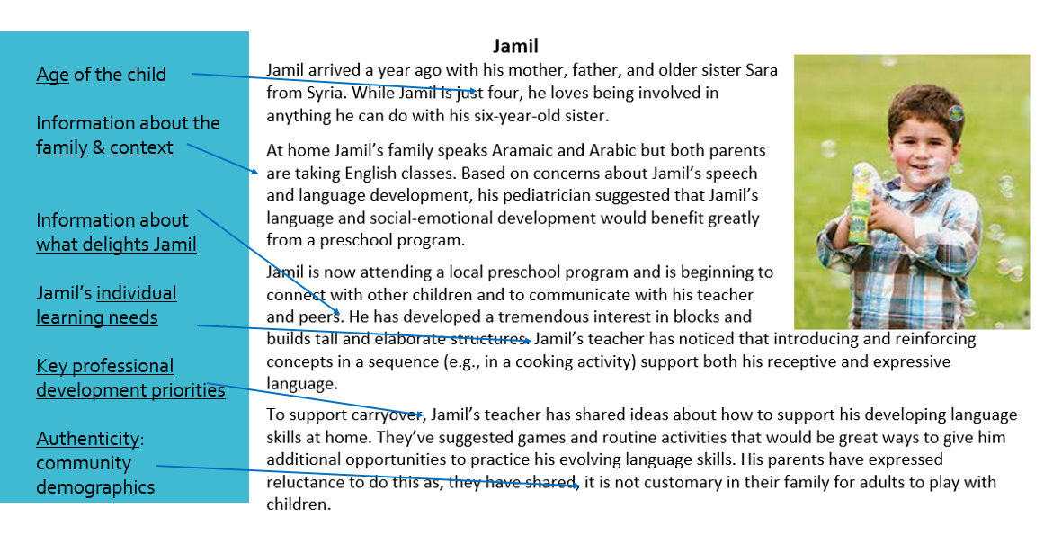

Slide 14

Vision Board Assignment
375A Infant Toddler Learning and Development
Vision boards are based on the law of attraction and the premise that we live in a universe that is dependent on our intentions. In order for it to work, a vision board must clearly show what we want in our lives. In addition to images, vision boards can include words, phrases, or sentences that affirm your intentions.
For this final assignment, I would like each of you to envision what you want for infants, toddlers, their families, and their caregivers. To begin, reflect on some of the “big ideas” we have learned about during the course. For example, we have discussed the importance of relationships, brain development, responsive caregiving, culture and language, developmental milestones of infancy, toddlerhood, and theories of infant toddler development – these are just a few!

Slide 15
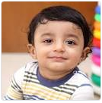
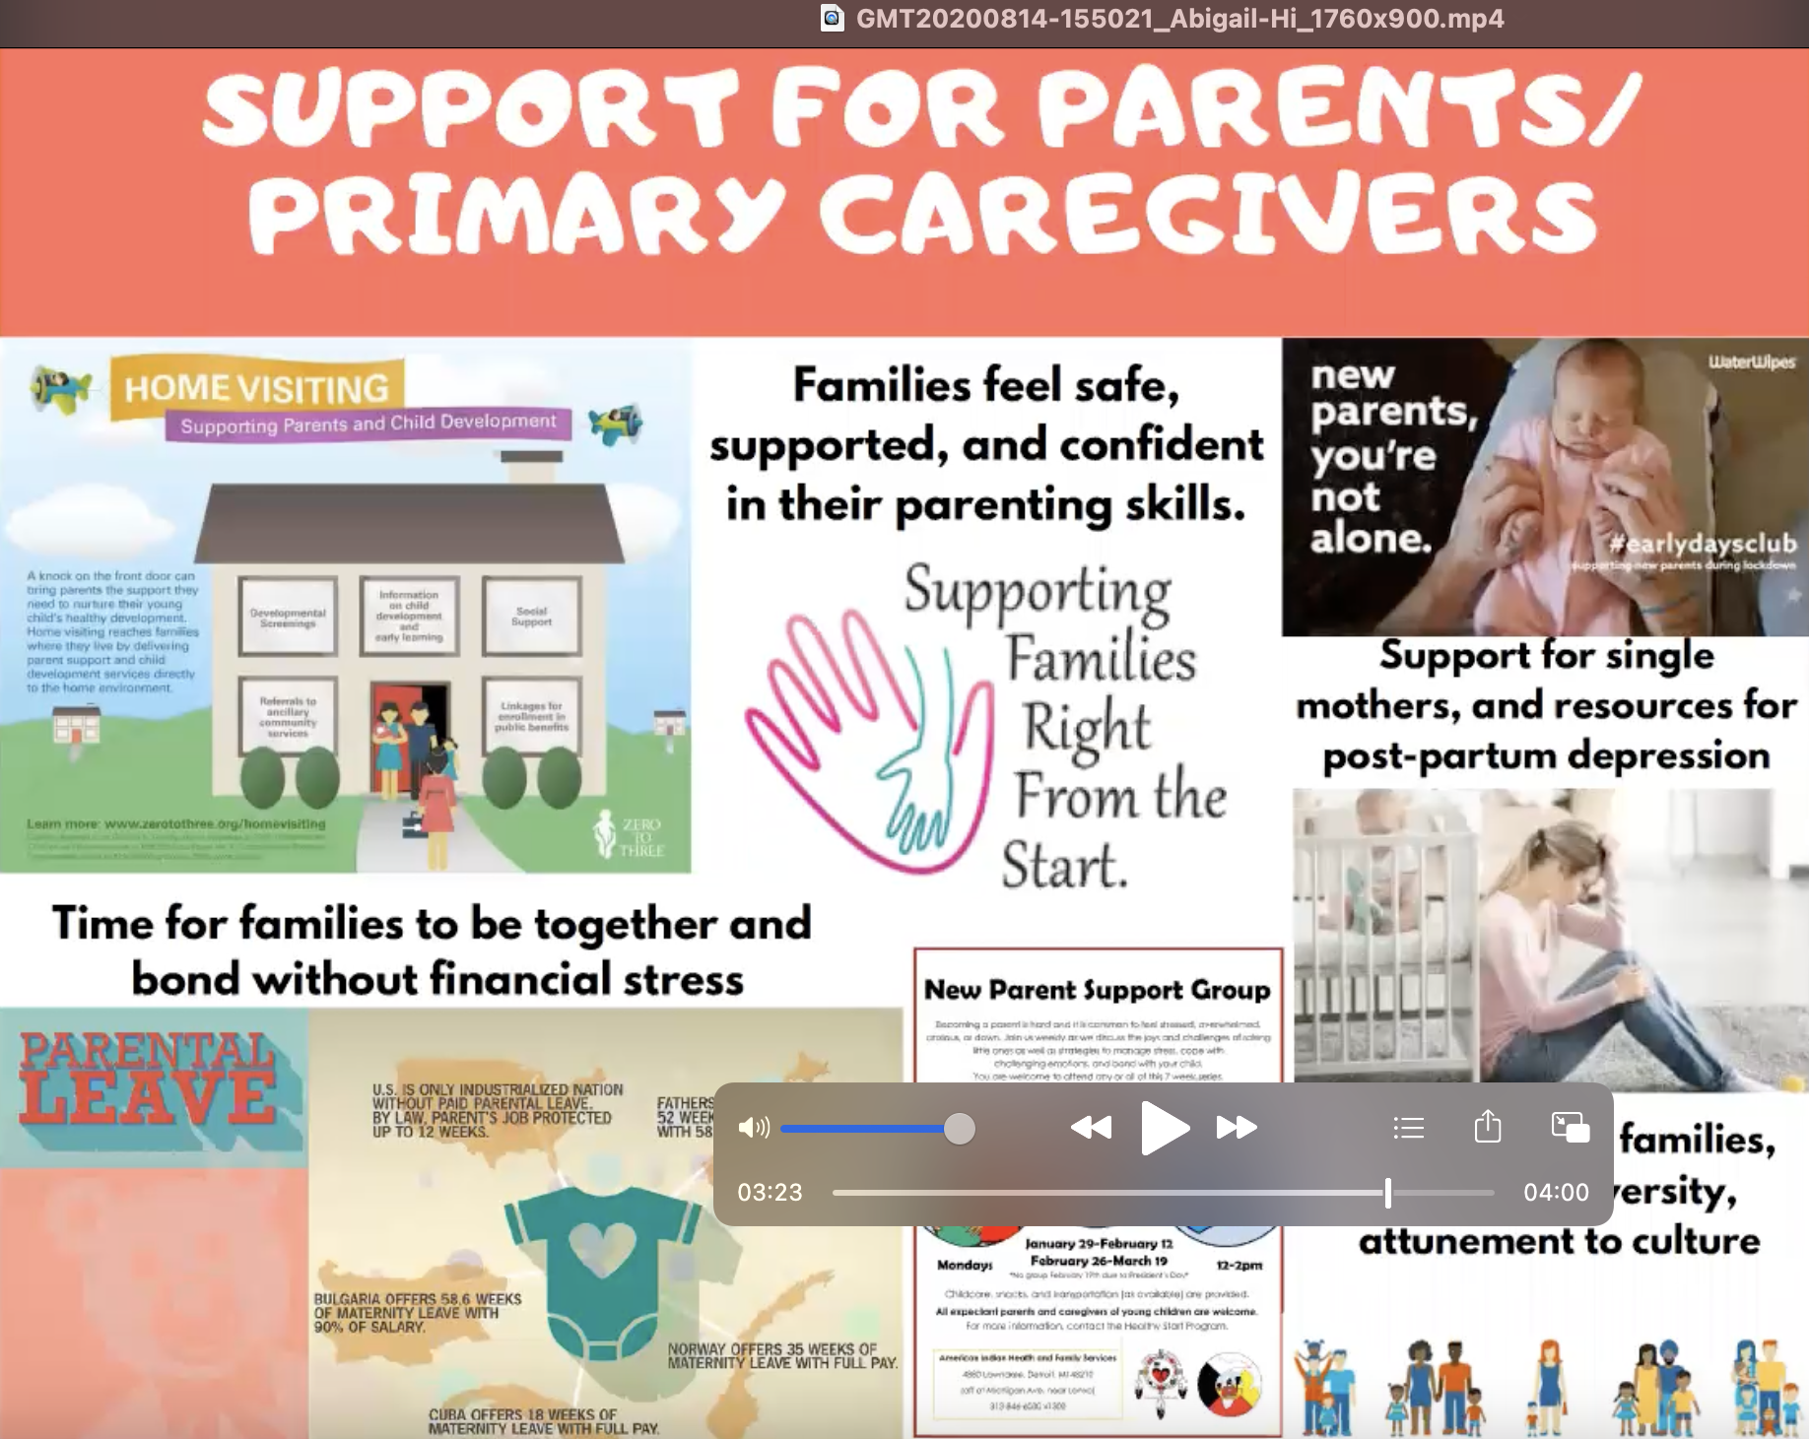
CFD 375A Human Development: Infant Toddler Development and Learning
“Razae ended up being qualified for home visiting and it was getting him very good results. It was helping the family. Home visiting promotes healthy relationships and is a very educational experience that can last a lifetime”.
Razae is 12 months old and has been placed in foster care since he was four months old. He was prenatally exposed to drugs and was placed in foster care because of domestic violence in the home. Emma and Andrew are the young couple who are providing foster care for the first time.
Razae is a very sweet, rambunctious boy who enjoys music and movement. He's also a great sleeper. Razae has learned how to walk, makes a variety of sounds, and is imitating others’ language consistently. Based on developmental delays in several domains, Razae qualified for and is receiving home-based early intervention services. He was slow to attach to his foster parents but is now bonding through play and enjoying skin to skin contact and other attachment-based activities. These are areas that were goals in Razae’s Individualized Family Service Plan (IFSP). He is thriving in this placement. Razae still visits his maternal grandmother and there is talk of placing him with her in the future.

Slide 16
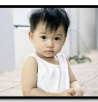

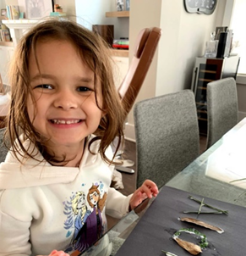
Infant/Toddler, Preschool, and Early Elementary Personas

Slide 17
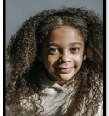
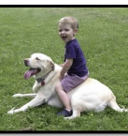
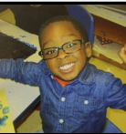
Michigan Personas

Slide 18
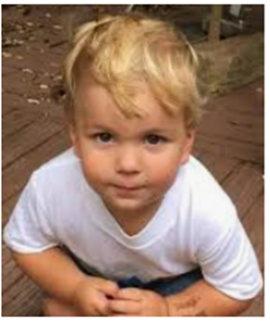
Persona + DAP
Trey is 30 months old. He lives with his mother who has some intellectual challenges. She takes very good care of Trey but she doesn’t know much about how to support the development of a toddler. By report, Trey has never used crayons, held or read books, or spent time with other children. Trey’s mom recently found a job, so Trey is now in a family childcare program each day. Based on concerns from Trey’s grandparents, he was recently evaluated and has an IFSP to support his language, fine motor, and social-emotional development. Trey’s therapy services are being delivered at the childcare.
Trey’s teacher says he plays with are cars, trains, trucks – anything with wheels. He avoids doing fine motor activities. When he is asked to do fine motor activities like completing simple puzzles, he appears to get frustrated, but doesn’t seem to be able to explain how he feels or why he’s unhappy.
Notes:
18

Slide 19
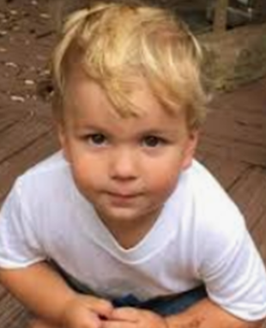
Opportunities
Ask students to identify what might be expected in fine motor, social emotional, and language development from a toddler, using state or national developmental milestones. Consider how that compares to Trey’s development.
Commonality
Ask students to identify the strategies they would use to collaborate with Trey’s mother to support his development.
Individuality
Ask students to propose ways to support Trey’s language, fine motor, and social-emotional development in his childcare program routines.
Context
Notes:
19

Slide 20

NAEYC defines “developmentally appropriate practice” as methods that promote each child’s optimal development and learning through a strengths-based, play-based approach to joyful, engaged learning (p. 5)

Slide 21
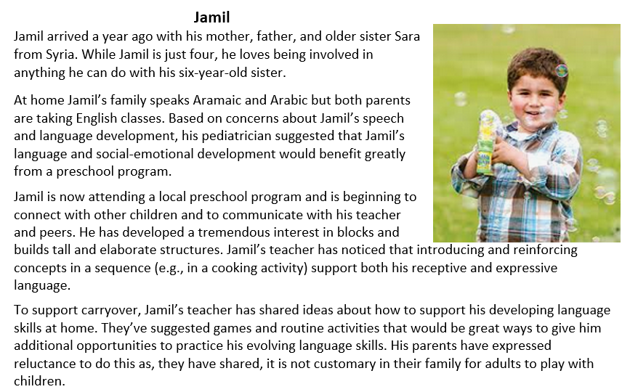
NAEYC defines “developmentally appropriate practice” as methods that promote each child’s optimal development and learning through a strengths-based, play-based approach to joyful, engaged learning (p. 5)

Slide 22
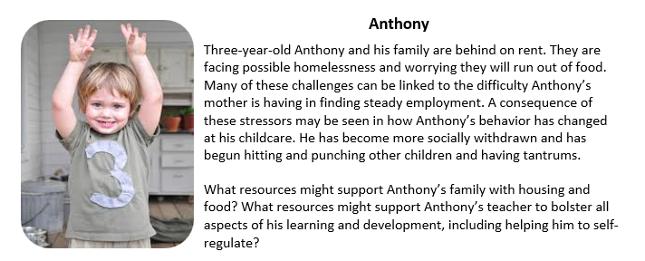
Using personas to build family engagement skills

Slide 23
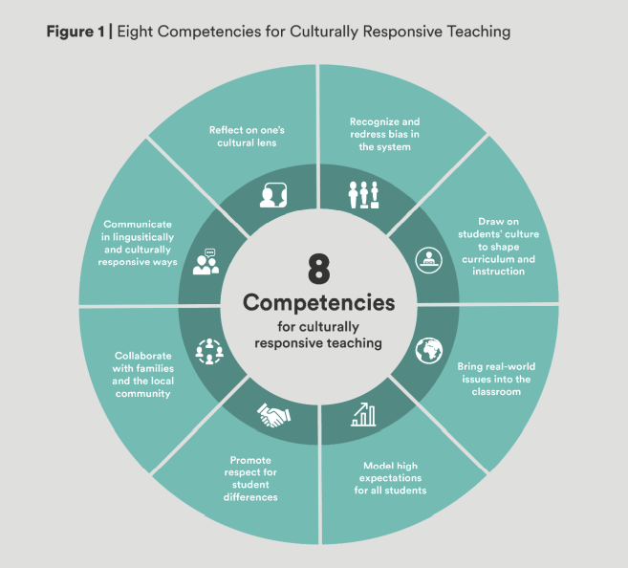
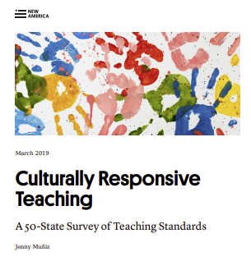
Persona + Culturally Responsive Teaching

Slide 24
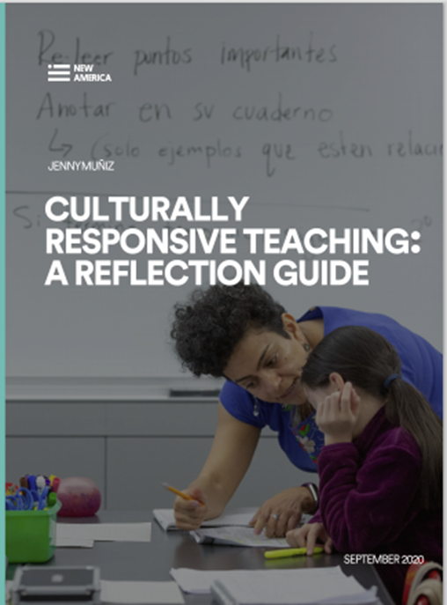
When did I become aware of my membership in various identity groups (i.e., those assigned by race, ethnicity, socioeconomic group, sexual orientation, and religion)?
What types of interactions did I have with individuals from identity groups different than my own growing up?
How does my identity shape my thinking, values, and understanding of the world?
How does my identity differ from the children and families I work with? How does it shape my interactions with children, families, and colleagues?

Slide 25
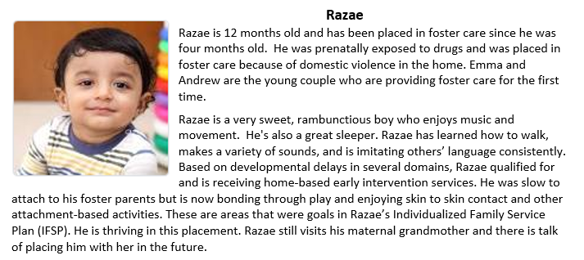
Assignment: Share how you would use 3 of the culturally responsive competencies to support Razae and his family.

Slide 26
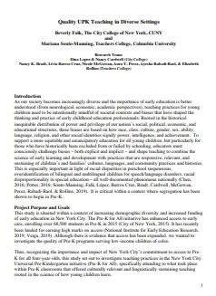
Principles for Advancing Equity
from Quality UPK Teaching in Diverse Settings
All children can learn
Young children’s learning is varied
Young children are active and multimodal meaning makers
Young children’s language practices are diverse, fluid, and flexible
Young children’s sociocultural contexts are assets and valuable resources for learning
Young children learn and develop within the context of caring and reciprocal relationships
Young children are critical thinkers and inquirers
Notes:
Quality UPK Teaching in Diverse Settings
https://highqualityearlylearning.files.wordpress.com/2020/11/report.quality-upk-teaching-in-diverse-setting.final_.pdf
https://highqualityearlylearning.files.wordpress.com/2020/03/principles-2.pdf (list)

Slide 27
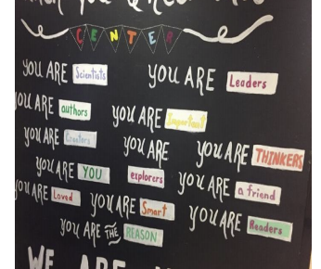
How do you convey to each and every child that they are a learner?

Slide 28
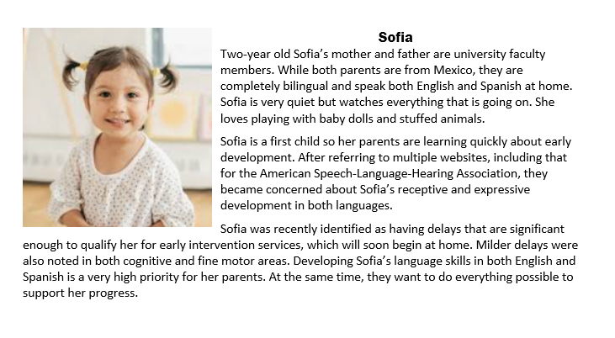
Persona + Equitable Learning Opportunities
What evidence-based practices would you use to support Sofia’s full and equitable participation?

Slide 29
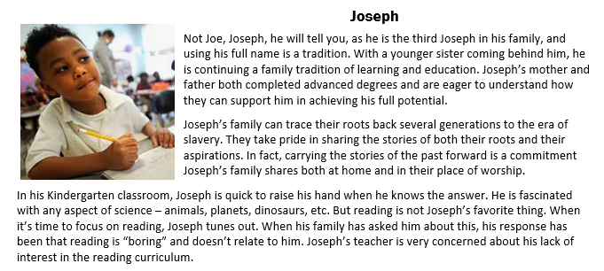
Personas + evidence-based practices for supporting young Black children

Slide 30
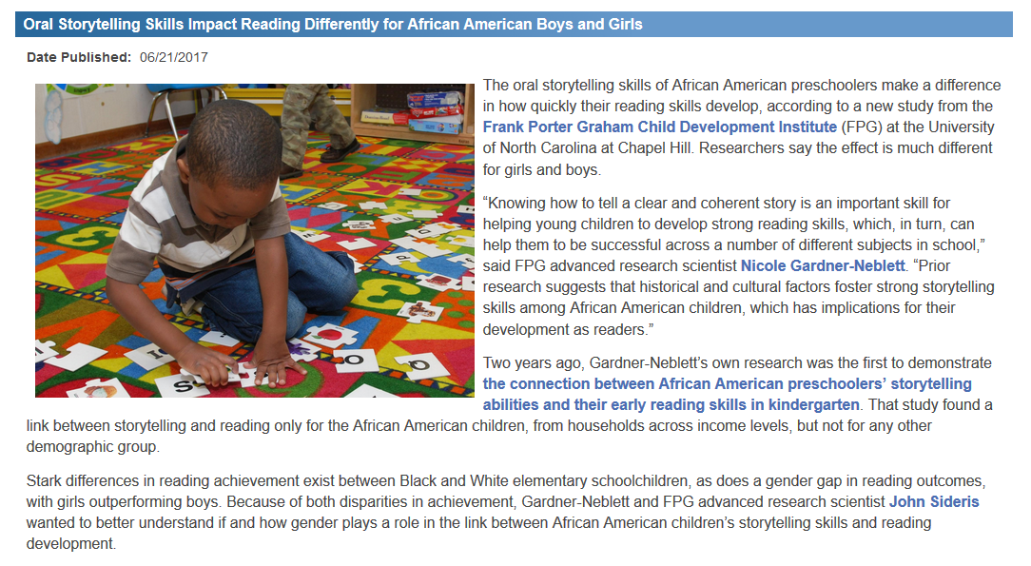

Slide 31

How might you use Joseph’s interest in science to support his literacy development?
What can you learn about evidence-based practices that support literacy in young black children?
What might you like to ask Joseph’s family about books and reading in their home?
If you were the teacher in Joseph’s classroom, what would your next steps be: 1) in terms of coordinating and collaborating with Joseph’s family; 2) in terms of implementing practices within the program that support Joseph’s needs? (and the needs of other children?)
If you were to select children’s books that might support Joseph’s interest in language and literacy, what process/parameters would you use?

Slide 32
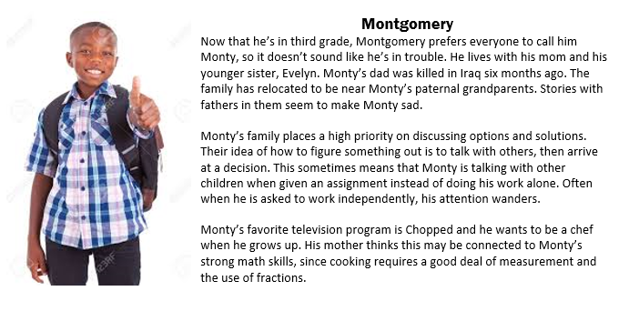

Slide 33

ORIGINAL
Develop three activities for teaching new, age- appropriate science concepts that incorporate the interests of the children and will capture/hold their attention.
MAKEOVER
Monty is one of the children in the 3rd grade class. Develop three activities for teaching new, age- appropriate science concepts that incorporate the interests of the children and require collaborative decision-making.
Notes:
33

Slide 34

Persona + evidence-based practices for children who are becoming multilingual
Ramon
Ramon is four years old and lives with his mom, dad, younger sister Maria, and his abuela. Ramon is the child most likely to come in from the playground with some living creature. At home he takes care of the family pets, and in the classroom, he frequently selects real, plastic, and stuffed animals to play with, especially dinosaurs.
Ramon is a sequential dual language learner. He speaks Spanish at home and has a 25-word site vocabulary. In his preschool classroom, Ramon is very quiet but watches intently to see what to do. He is picking up new labels in English every day. Ramon’s parents are very eager for him become fluent in English so he can be successful in school and life.

Slide 35
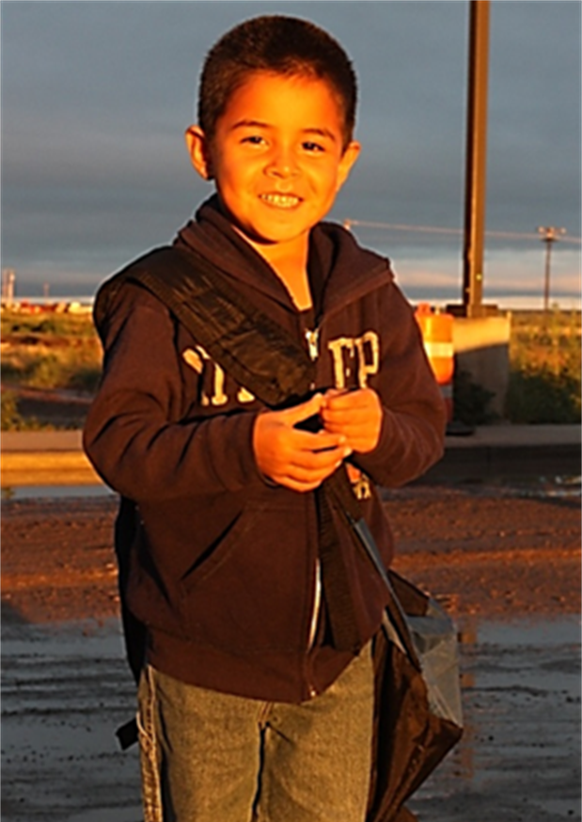
I want my students to
Understand the assets for children of being bilingual
Understand the phases of second language acquisition for children who are dual language learners
Understand how to support children who are dual language learners in inclusive early childhood classrooms

Slide 36

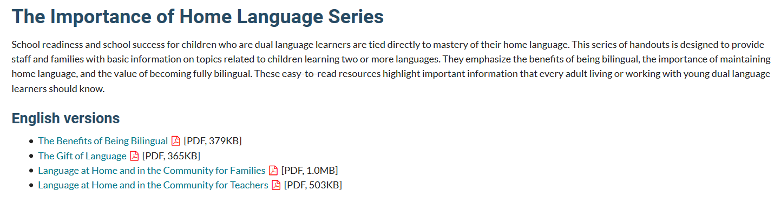

Slide 37
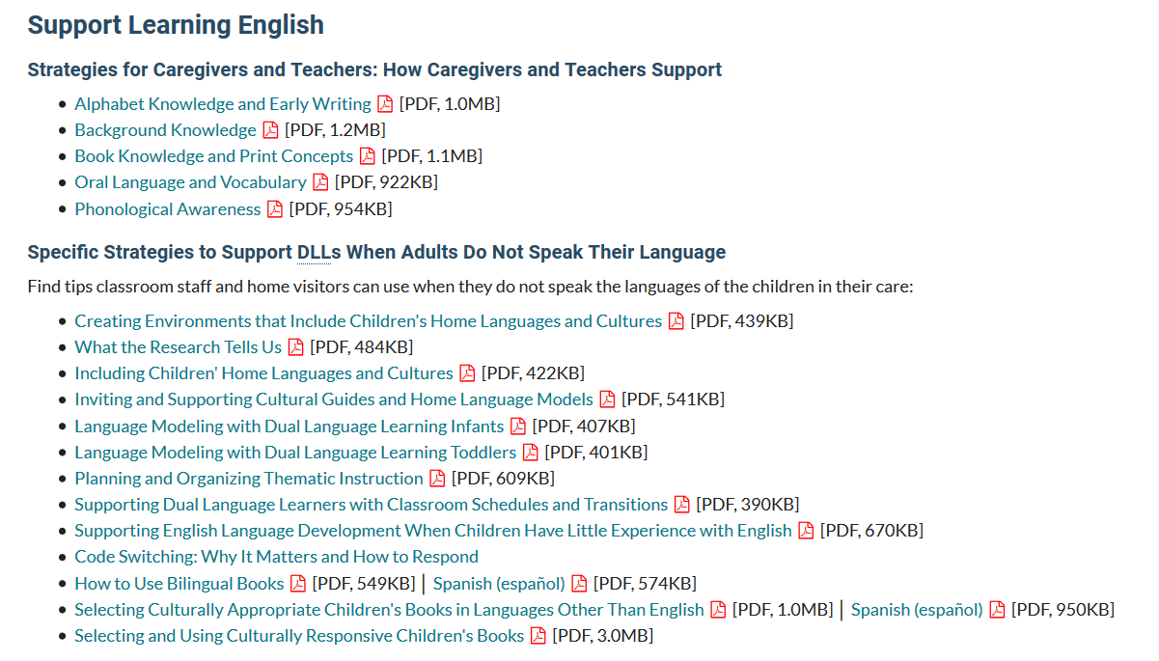

Slide 38
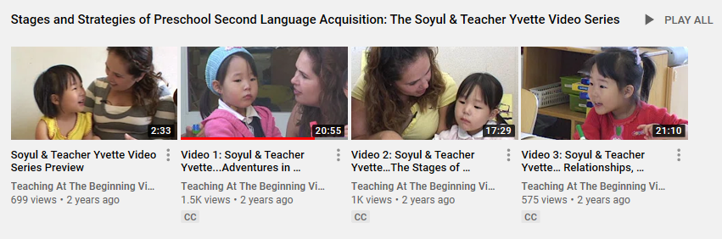

Slide 39
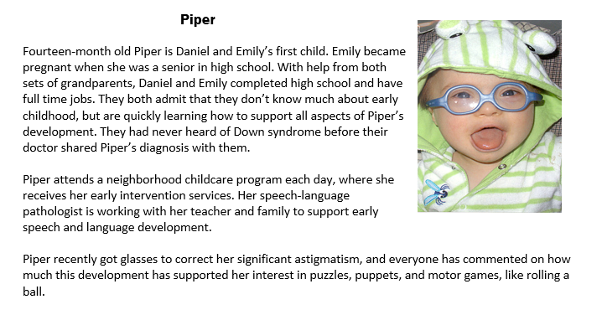
Persona + evidence-based practices that support inclusion

Slide 40
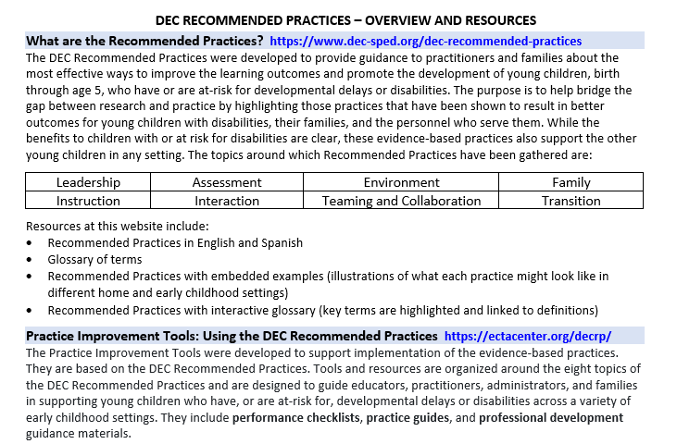
DEC Recommended
Practice Resources

Slide 41
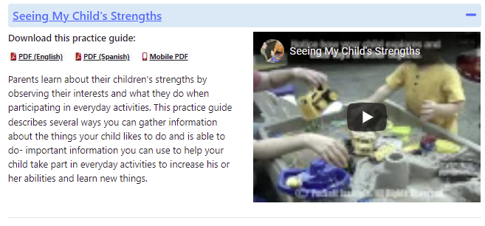
Practice Guides for Families in English and Spanish

Slide 42
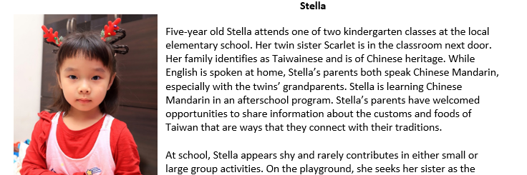
Other uses for personas + RP tools

Slide 43
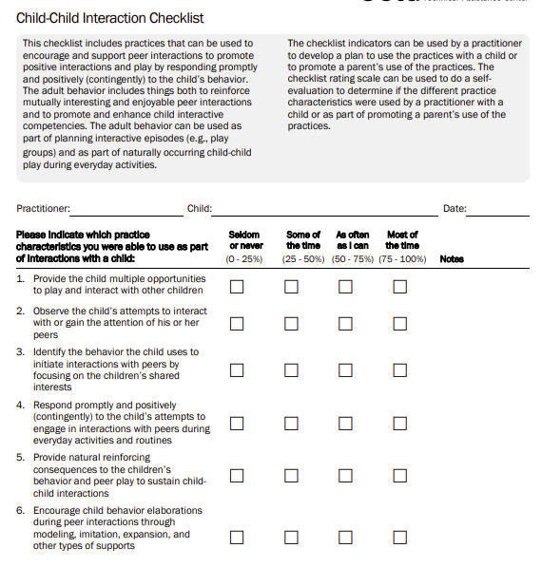
Practice Guides for Professionals in English and Spanish
Options for building cohesion between course content and field experience

Slide 44
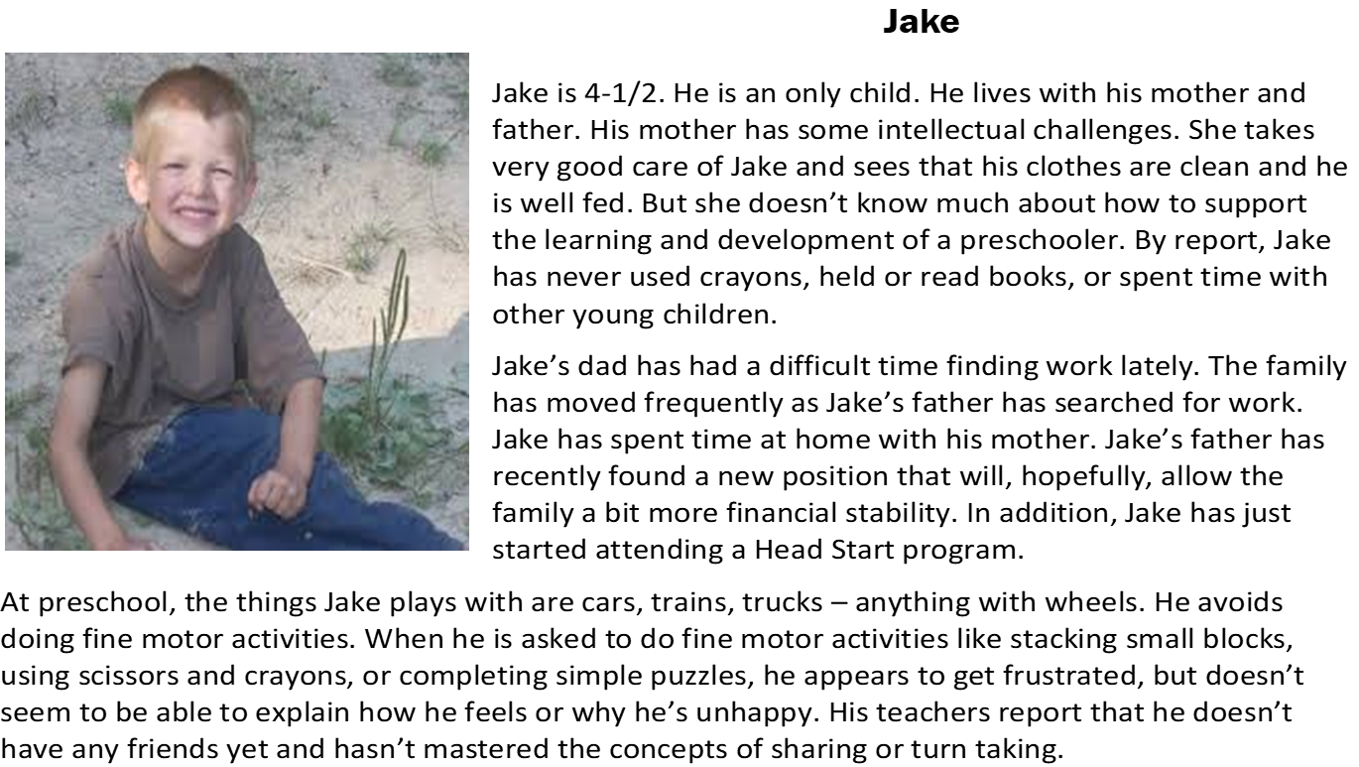
Using personas to support individual learners

Slide 45
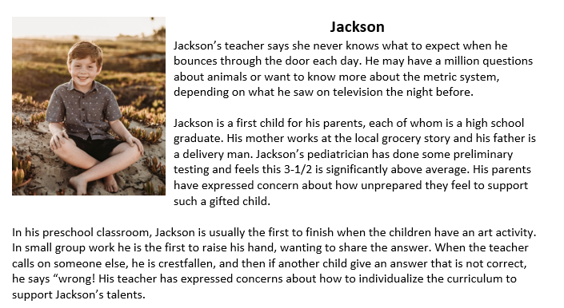
Using personas to support individual learners

Slide 46
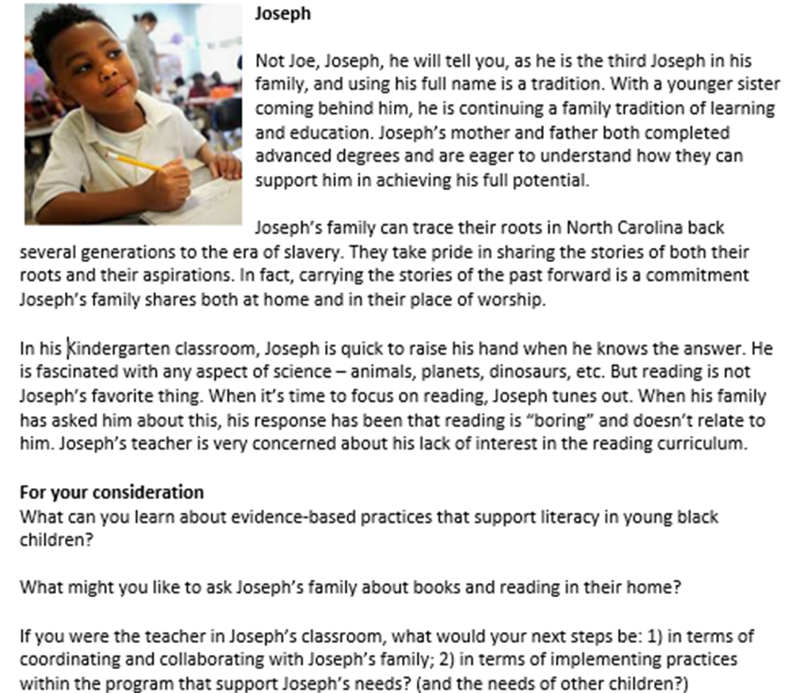
Using personas to support individual learners

Slide 47
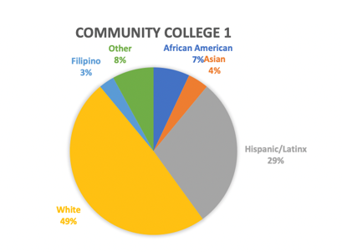
Use personas to be responsive to college student/community demographics

Slide 48
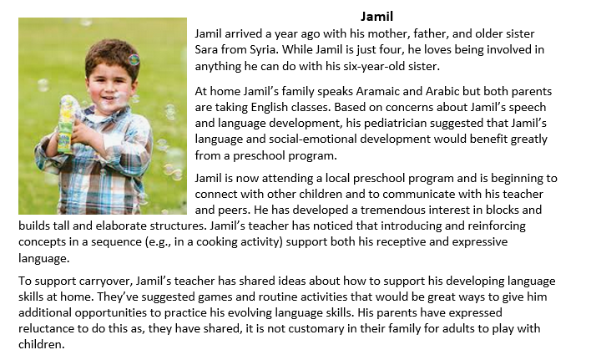
Persona + opportunities for culturally responsive and safe practice

Slide 49
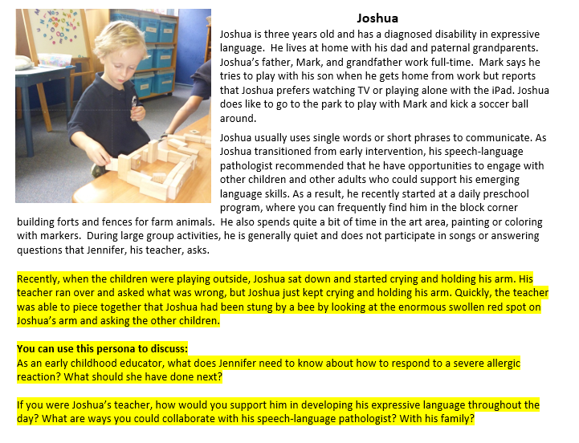
Personas may be customized
Persona + Health, Safety, & Nutrition

Slide 50

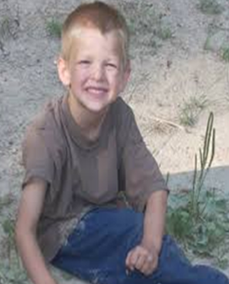
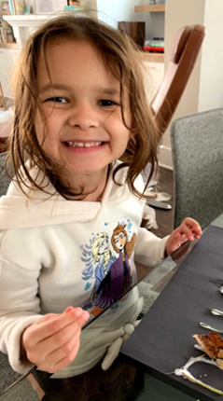
Use a current assignment, e.g., design a math or science learning center for a preschool classroom
BUT let your students know that Ramon, Jake, and Lainie are three of the children in that class. Their assignment will then be to design a learning center that will engage and support each child, including these three. You can also ask students to identify the evidence sources they drew their ideas from.

Slide 51
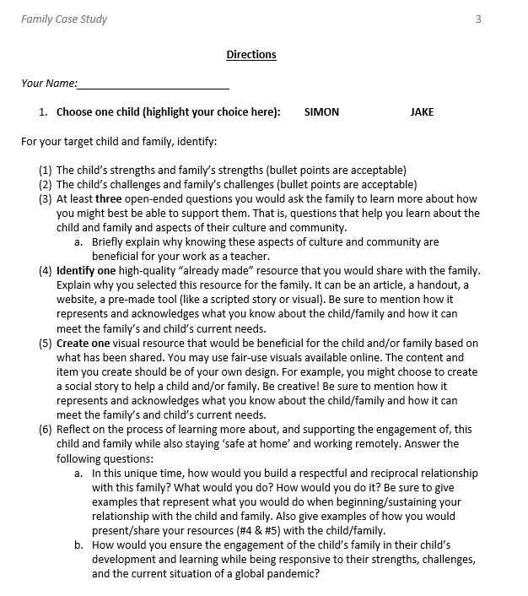
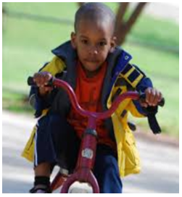
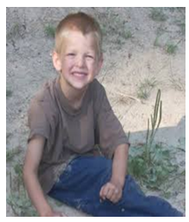

Slide 52

More examples on page 3 of the handout

Slide 53
Evidence for the use of personas
From the chair of an ECE program: “Personas give the students a story and they put more effort into assignments because they are not so abstract.”
From a field experience supervisor: “The photo and details make the personas real to the students to they really want to figure out how to support the child and family.”
From an early childhood student: “I really enjoyed the personas. I found them to be more realistic and current with the children and families we have within our state.”

Slide 54

What bubbled up for you?

Slide 55

EXIT TICKET
What’s one early childhood capability you could build using the Dusty persona?

Slide 56

This Photo by Unknown Author is licensed under CC BY-NC

