Slide 1


Using a Strength-Based Approach to Including and Supporting the Neurodivergent Young Child
March 7, 2025
Laura J. Hall, Ph.D.,
Project PIPELINES
San Diego State University
ljhall@sdsu.edu
Paul Luelmo, Ph.D.
Project PIPELINES
San Diego State University
pluelmo@sdsu.edu

Slide 2
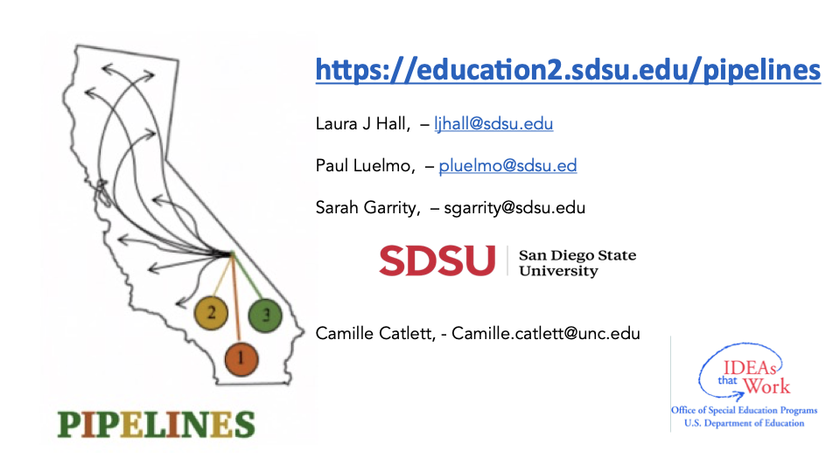

Slide 3


Slide 4

Presentation
OUTLINE
a) describe the neurodivergent child
b) identify frequent strengths of young neurodivergent child to affirm, enhance, and build upon
c) describe challenges associated with characteristics
d) describe ways that early childhood educators can arrange environments and create opportunities to facilitate the inclusion of young children
e) review resources that can be used by early childhood educators
LUNCH
f) Define Universal Design for Learning
g) describe evidence-based practices and strategies that support successful inclusion of young neurodivergent children

Slide 5

What is autism?
A neurodevelopmental difference
From multiple causes, likely contributed to by genetic influences (as originally determined by twin studies), & environmental influences, including those in utero
resulting in
a difference in brain development and functioning

Slide 6
What is neurodiversity?
Baumer & Freueh, 2021 - Harvard Health Publishing
Neurodiversity describes the idea that people experience and interact with the world around them in many different ways; there is no one "right" way of thinking, learning, and behaving, and differences are not viewed as deficits.
The word neurodiversity refers to the diversity of all people, but it is often used in the context of autism

Slide 7
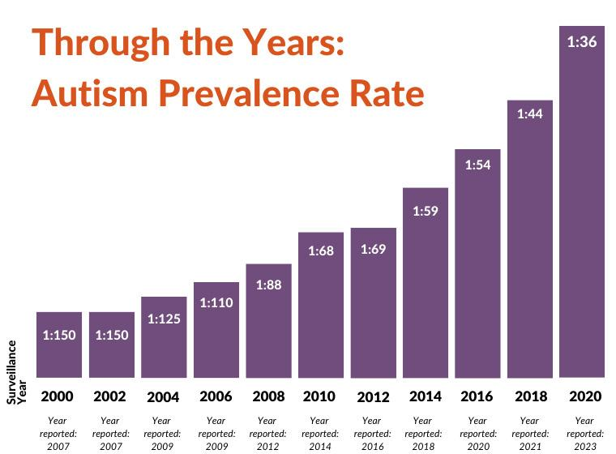
In the USA

Slide 8
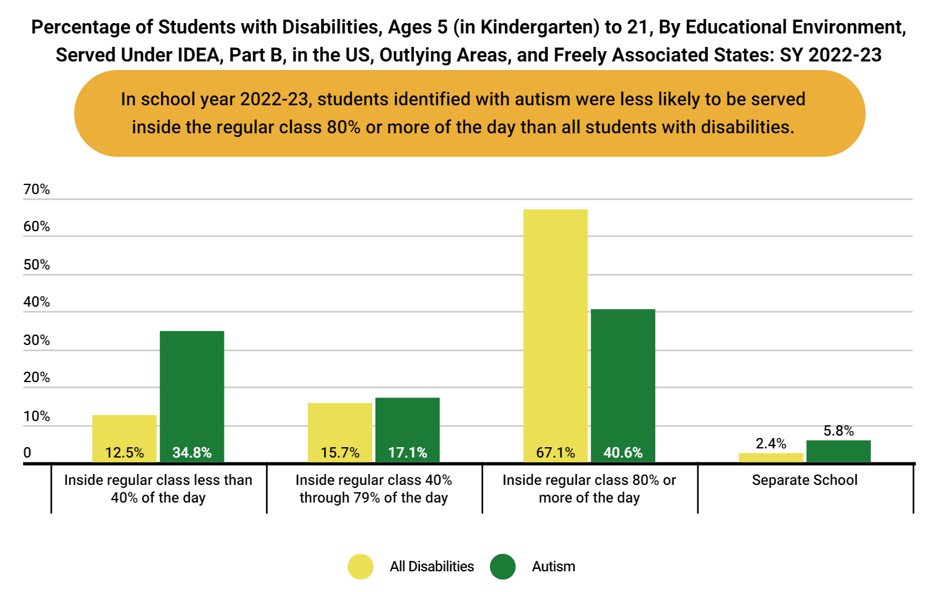
US, DED, Office of Special Education Programs, March, 2024

Slide 9

Dr. Stephen Shore –
author, professor & self-advocate
“If you've met one person with autism, you've met one person with autism…”

Slide 10
Common Characteristics
Strengths | Contributions | Challenges | Evidence-based Practices & Supports
Follows rules- preference for Routine | Tour guide, Chef, Farm management

Slide 11
Common Characteristics
Strengths | Contributions | Challenges | Evidence-based Practices & Supports
Follows rules- preference for Routine | Tour guide, Chief, Farm management
Sustained focused attention to interests | Rail system manager Security officer

Slide 12
Common Characteristics
Strengths | Contributions | Challenges | Evidence-based Practices & Supports
Follows rules- preference for Routine | Tour guide, Chief, Farm management
Sustained focused attention to interests | Rail system manager Train Conductor
Attention to detail | Data - entry

Slide 13
Common Characteristics
Strengths | Contributions | Challenges | Evidence-based Practices & Supports
Follows rules- preference for Routine | Tour guide, Chief, Farm management
Sustained focused attention to interests | Rail system manager Security Guard
Attention to detail | Data - entry
Interest in facts, letters, numbers | Investigator Editor

Slide 14
Common Characteristics
Strengths | Contributions | Challenges | Evidence-based Practices & Supports
Follows rules- preference for Routine | Tour guide, Chief, Farm management
Sustained focused attention to interests | Air traffic control Train Conductor
Attention to detail | Data - entry
Interest in facts, letters, numbers | Investigator Editor
Responses to sensory stimuli | Musician, Artist Sound Engineer Video game designer

Slide 15
Common Characteristics
Strengths | Contributions | Challenges | Evidence-based Practices & Supports
Follows rules- preference for Routine | Tour guide, Chief, Farm management
Sustained focused attention to interests | Air traffic control Train Conductor
Attention to detail | Data - entry
Interest in facts, letters, numbers | Investigator Editor
Responses to sensory stimuli | Musician, Artist Sound Engineer Video game designer
Strong Moral Compass | Judge, Referee, Lawyer

Slide 16
Building STRENGTHS - Supporting CHALLENGES

Slide 17
Common Characteristics
Strengths | Contributions | Challenges | Evidence-based Practices & Supports
Follows rules- preference for Routine | Tour guide, Chief, Farm management | Change in Routine Coping with Frustration
Sustained focused attention to interests | Air traffic control Train Conductor | Transitions from preferred activities
Attention to detail | Data - entry | Big Picture
Interest in facts, letters, numbers | Investigator Editor | Prediction Perspective taking
Responses to sensory stimuli | Musician, Artist Sound Engineer Video game developer | Sensory input as negative
Strong moral compass | Judge, Referee, Lawyer | Peer Interaction Social Communication

Slide 18
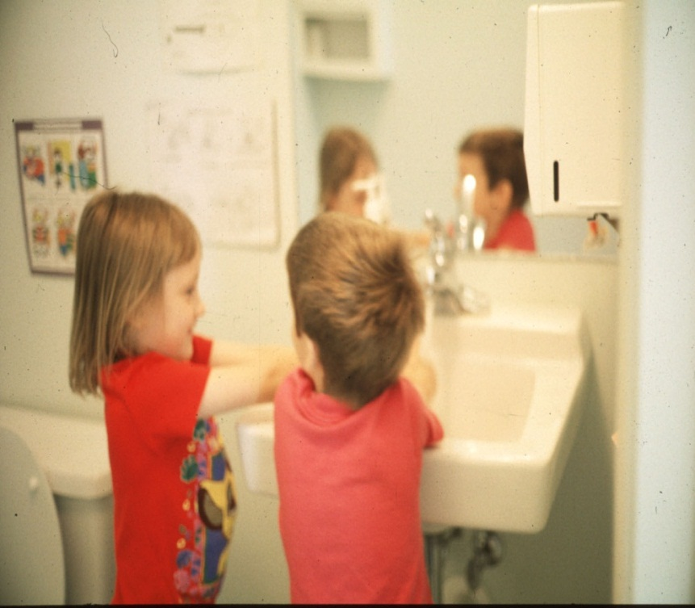
Outcomes of Inclusive Settings (Schwartz, Staub, Gallucci, & Peck, 1995)
Participation
  As other classmates
Engagement
  Meaningful involvement
Relationships
  Formation of friendships

Slide 19

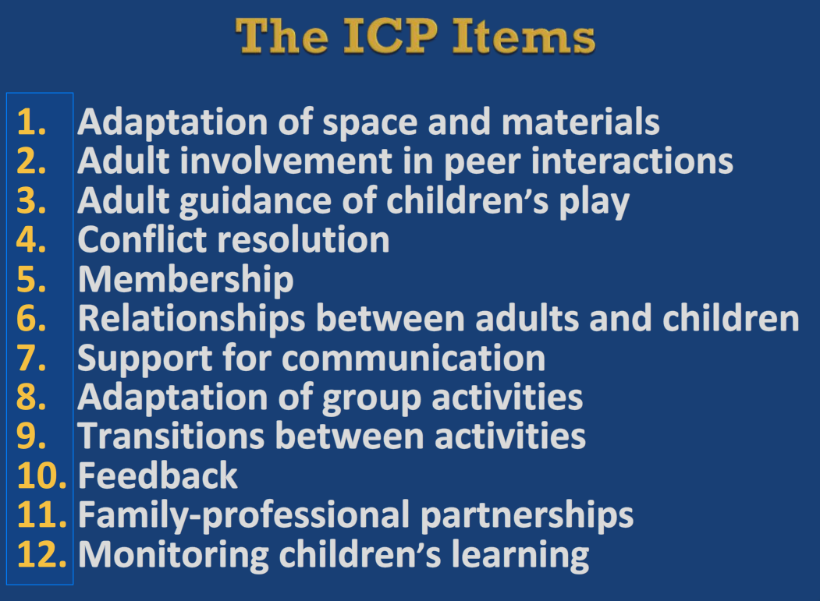
Quality of Inclusion
http://npdci.fpg.unc.edu/sites/npdci.fpg.unc.edu/files/images/features/ICP_Module_1.swf

Slide 20


Slide 21

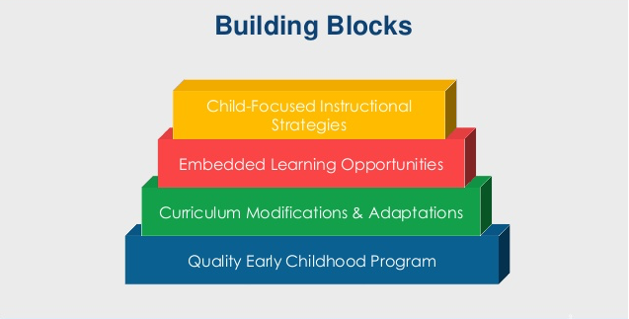
Building Blocks

Slide 22
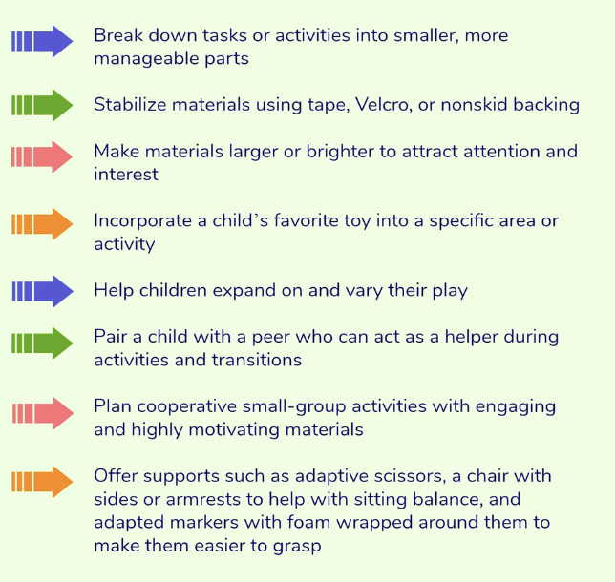
Building Blocks Curriculum Modications
Notes:
PAUL

Slide 23
Common Characteristics
Strengths | Challenges | Evidence-based Practices & Supports
Follows rules- preference for Routine | Change in Routine Coping with Frustration | Visual Supports – (Visual schedules)
Sustained focused attention to interests | Transitions from preferred activities | Visual Timer to indicate time to change Naturalistic Interventions Self-management
Attention to detail | Big Picture Goal Setting | Task Analysis
Interest in facts, letters, numbers | Prediction Perspective taking | Naturalistic Intervention Video modeling
Responses to sensory stimuli | Sensory input as negative | Accommodations – cap with lid, head set – Gradual introduction
Strong moral compass | Peer Interaction Social Communication | Peer-based Instruction & Intervention

Slide 24



https://ncaep.fpg.unc.edu/

Slide 25
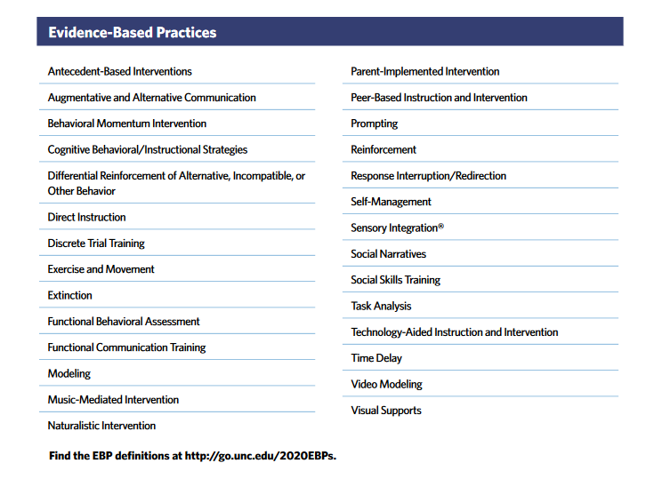
Steinbrenner et al., 2020

Slide 26
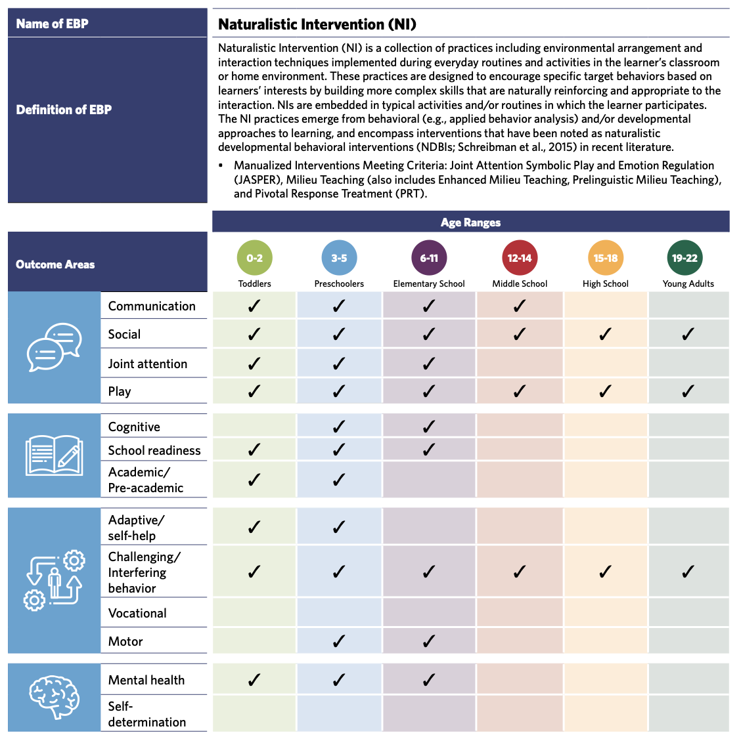

Slide 27
AFIRM Website
https://afirm.fpg.unc.edu/afirm-modules

Slide 28
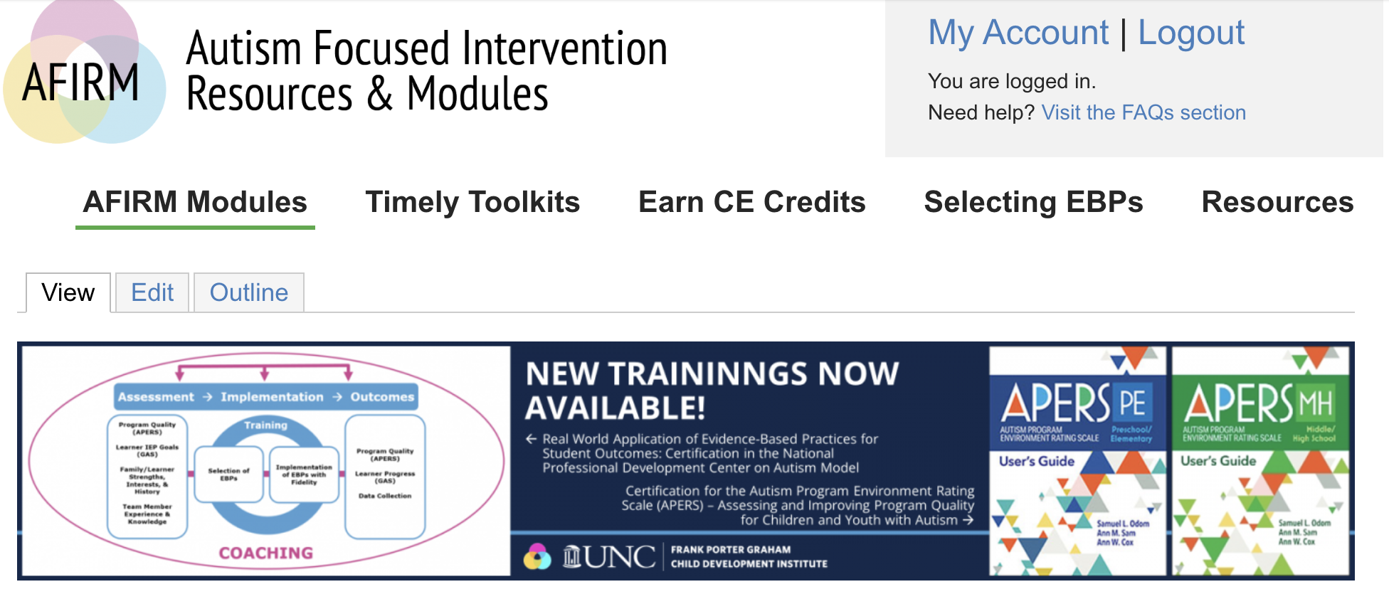

Slide 29

Notes:
https://www.captain.ca.gov/documents/leadershiproster20240918.pdf

Slide 30


https://www.seedsofpartnership.org/familyEmpowerment.html

Slide 31
The Story of Maria and Jose
Notes:
I’d like to start with the story of one family, that in reality represent many families I have worked with over the years in a mostly immigrant community in Los Angeles and as a special education teacher. But I will give this child the name of Jose. Jose was a young child identified with autism, and Maria, his mother, was not only focused on the social deficits he saw in Jose, Maria, was also undocumented in a feared for the future of Jose as he was identified as being different than most young children. As a special educator, I was no only tasked to highlight the strengths of Jose, but also, the resilience of Maria’s family given the vulnerable situation of undocumented status in this country. Because you’ll see that not only Jose had strengths, but Marias was also gifted with the resilience to move her family forward. These differences then, are seen as strengths, vulnerability as strength.

Slide 32
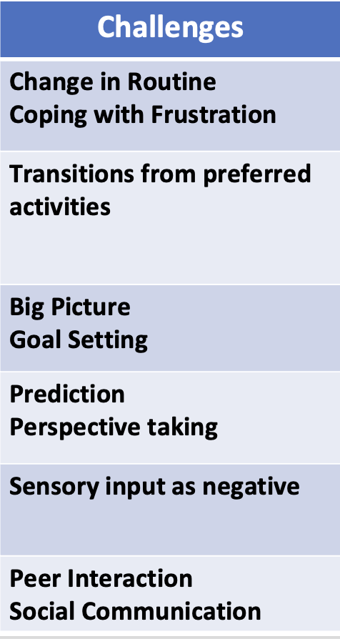
From a
Deficit-oriented Perspective.
Notes:
At first, Maria and his teachers focused on Jose’s deficits, or challenges, for example, it was hard for him to change activities within the classroom, this resulted in disruptive behaviors. Jose loved trains, and it was hard for him stop playing with them to move into another activity in the classroom. He used to focus on the details of things, like the wheels of the trains, but not on how the train move from point A to point B. For Jose, it was hard to understand that other children wanted to play in different ways from his, in a way a bit rigid.

Slide 33

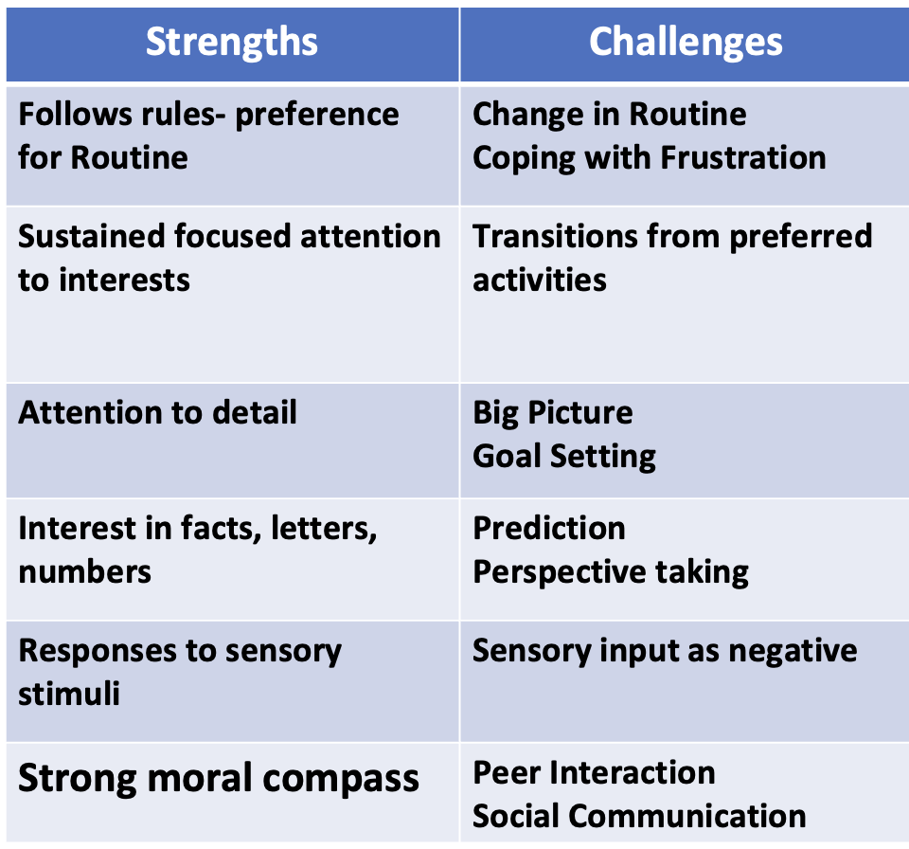
To a Strengths-based
Approach
Notes:
At first, Maria and his teachers focused on Jose’s deficits, or challenges, for example, it was hard for him to

Slide 34
Common Characteristics
Strengths | Challenges | Evidence-based Practices & Supports
Follows rules- preference for Routine | Change in Routine Coping with Frustration | Visual Supports – (Visual schedules)
Sustained focused attention to interests | Transitions from preferred activities | Visual Timer to indicate time to change Naturalistic Interventions Self-management
Attention to detail | Big Picture Goal Setting | Task Analysis
Interest in facts, letters, numbers | Prediction Perspective taking | Naturalistic Intervention Video modeling
Responses to sensory stimuli | Sensory input as negative | Accommodations – cap with lid, head set – Gradual introduction
Strong moral compass | Peer Interaction Social Communication | Peer-based Instruction & Intervention

Slide 35
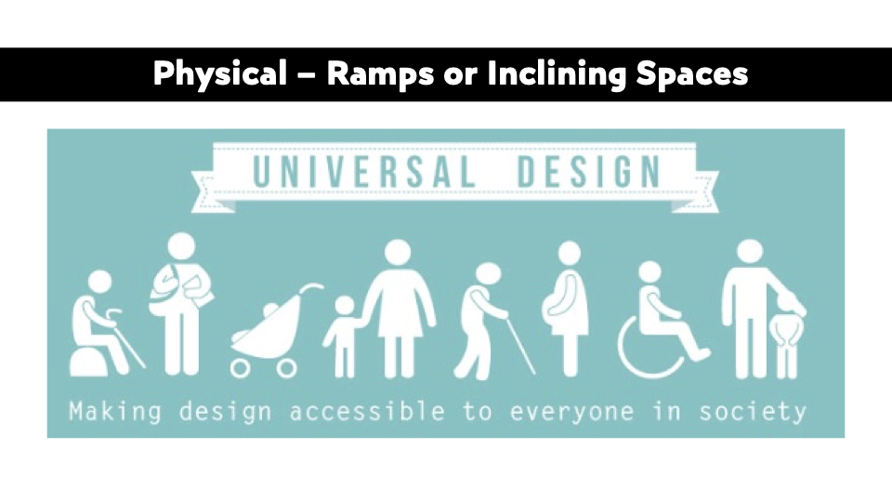
Notes:
PAUL

Slide 36
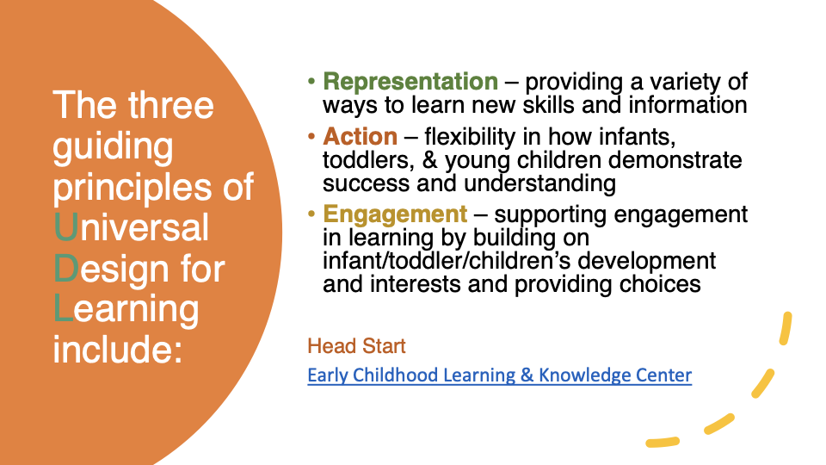
Notes:
PAUL

Slide 37

Visual Supports- Schedule
Add a ? in the schedule to support change and the unknown and pair with something positive at first
Offering choice is empowering
Notes:
PAUL

Slide 38
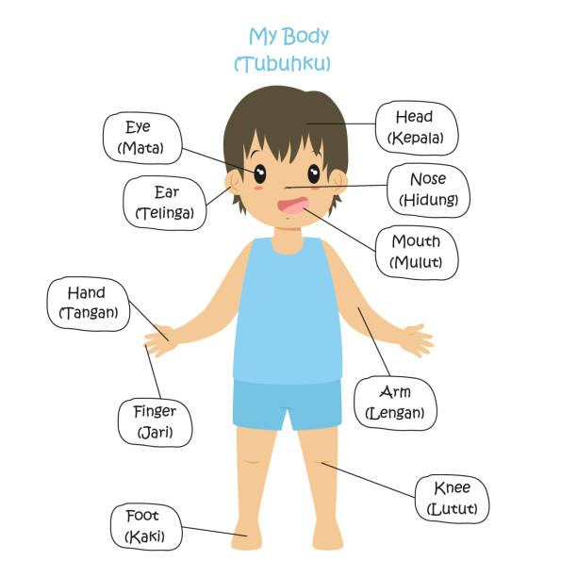
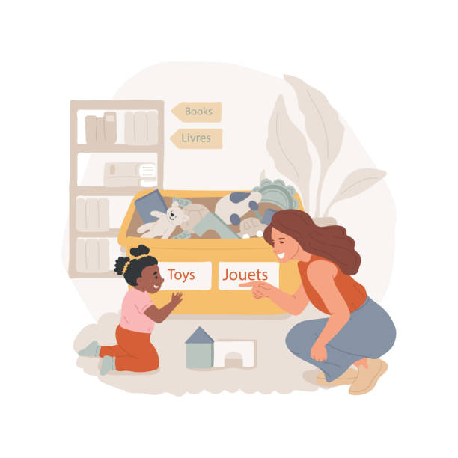
Include Signs, Books, in Multiple Languages
Notes:
PAUL

Slide 39




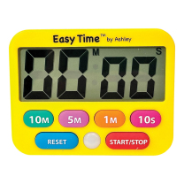
Visual Timer to support transitions
Notes:
PAUL

Slide 40
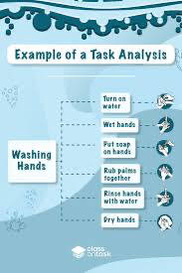
Understanding big picture – steps towards goals
Using a task analysis to identify steps
Clearly stating the parts of a sequence of events – perhaps of a routine used in the centre or at home
Notes:
PAUL

Slide 41
Using Technology to implement UDL
Gen-AI: Example
Notes:
PAUL

Slide 42

Incorporate Interests
Think Pair Share
Early on, learn from parents if child has focus interests
Use as motivator, first <engagement> then <interest>
First (engagement) then special interest
Notes:
Activity

Slide 43

Give Choices
  Resources:
  AFIRM Naturalistic Intervention Module
  AFIRM Visual Supports Module
For participation and engagement
  Have two or more options
  Use words to describe
  Use visual symbols
  Use objects

Slide 44




Possible items to accommodate sensory challenges
Notes:
PAUL

Slide 45
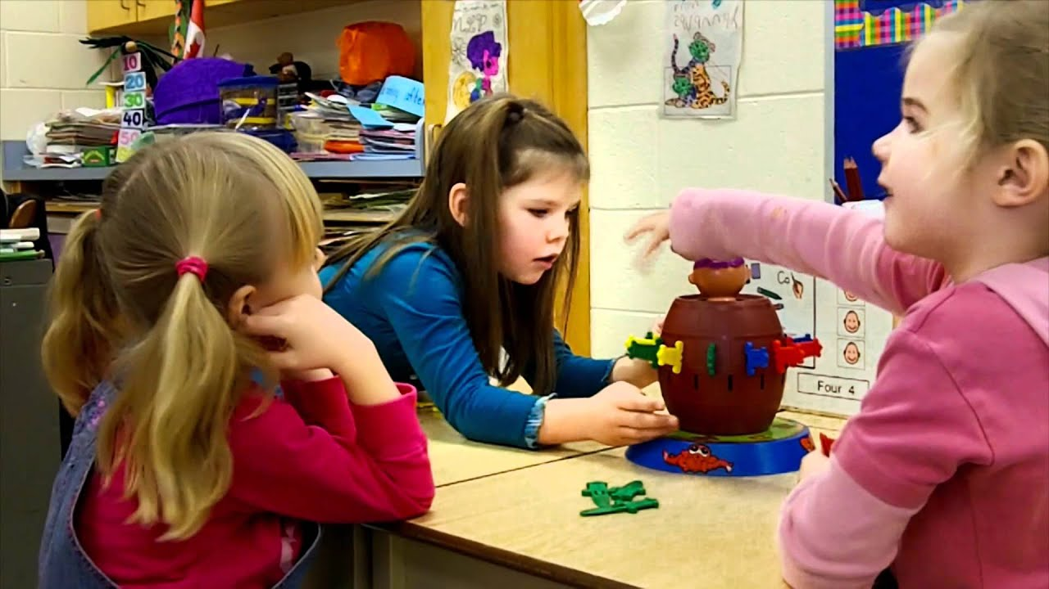
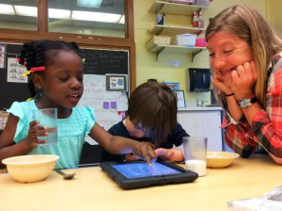
Peer-based practices
Involve peer directly in supporting autistic child
  Structured Play Groups
  Peer mediated intervention
  Peer support
  Resources:
  AFIRM Peer-based Intervention Module
  Building Blocks Curriculum Modifications

Slide 46

Peer interaction – Video modeling
Module: AFIRM Modeling

Slide 47
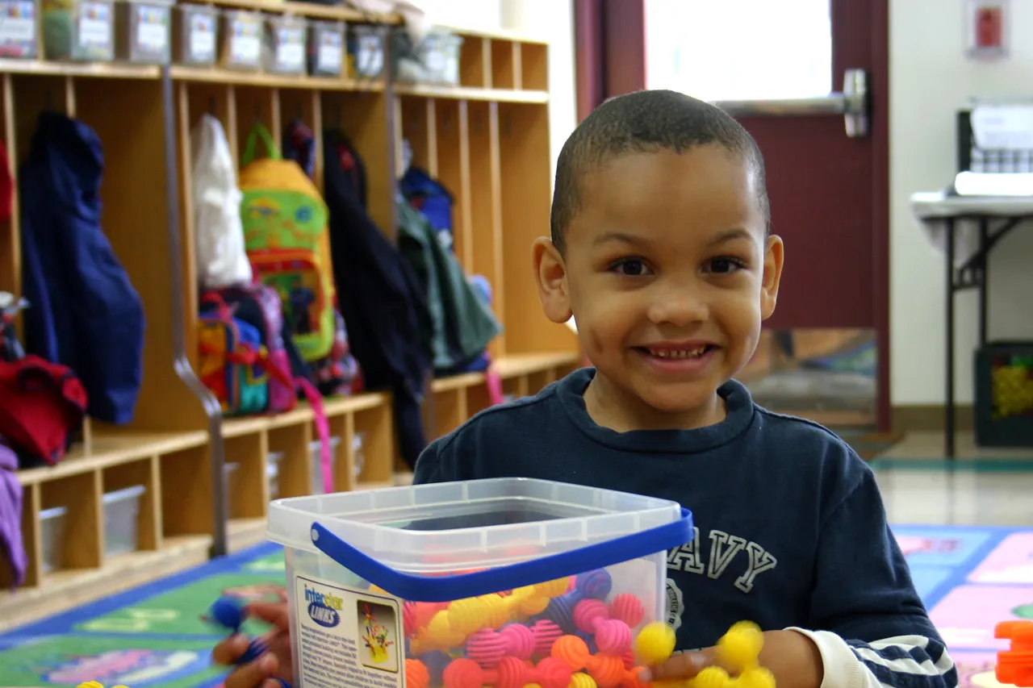
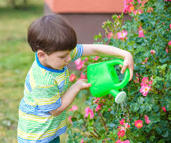
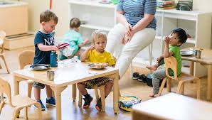
Assign Classroom Tasks
Think about tasks that child can help with in the classroom and assign
  Passing out rugs for sitting on floor
  Giving napkins or snacks at snack time
  Putting blocks or toys back in area
Resources:
AFIRM Visual Supports
Building Blocks:
Curriculum Modifications
Notes:
Strengths based- there is nothing more empowering and motivating for a child than to give them choice. Teacher can have a discussion about what tasks, identified by the students, Identifying strengths and offering choice. Modeling- neurodivergent child, IF child does not get an assignment, making sure that everybody makes assigned a task. Nobody gets left out. Modeling a strengths based approach.

Slide 48
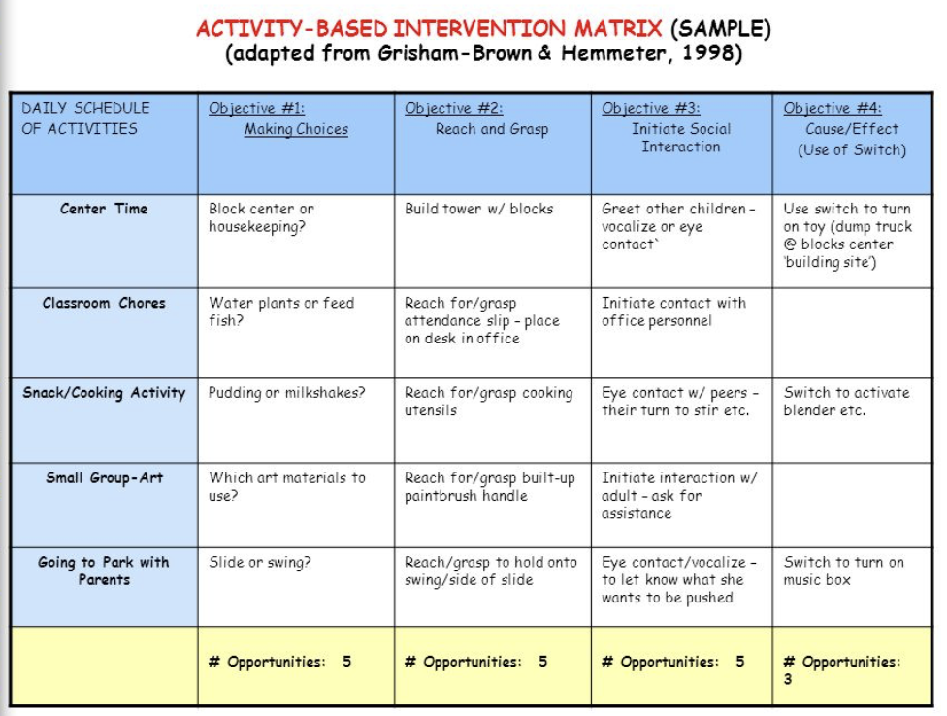
Look at schedule for times to embed learning
Plan ahead by looking at schedule and plan times for child engagement
  Group time
  Centers time
  Snack
Resources
  AFIRM Module: Naturalistic Intervention
  Building Blocks: Curriculum Modifications

Slide 49

Questions?
  Laura J. Hall
  ljhall@sdsu.edu
  Paul Luelmo
  pluelmo@sdsu.edu
Notes:
Please reach out to our project staff if you have any questions.

